Slide 1
Environmental Studies Semister 1

Slide 4
Environment
Environment is surroundings. It includes physical, chemical and biotic forces. In the environment there are interactions between plants, animals, soil, water, temperature, light, and other living and non-living things.
Every factor of environment has its effects on our life and our activities.
It includes natural and cultural or human environment.
It is a live system which includes living and non living components which interact in a very complex way.
The protection and proper utilization of environment are necessary for the survival of human civilization.

Slide 5
Aims & Importance of Environmental Studies
Environmental study is a systematic study of environmental factors which influence life on the earth . It is a knowledge which involves the better understanding of natural forces that may affect the physical and emotional health of man and his well being.
In other words, environmental science is a logical study of complex physical and biotic factors.
Aims are:
Develop understanding of various environmental issues and concerns of National and global importance.
Develop a balanced view of the relationship between environment and development.
To develop a deeper concern for the environment .
To appreciate the role of individual, community, national and international agencies in resolving environmental problems.
Respect customs and traditions related to local conservation practices and accept eco friendly technologies.
Participate in activities in dealing with environmental problems.

Slide 6
It helps us to understand the relation between man and environment.
It helps us to understand components of environment and the interrelations amongst its components.
It gives insight about how a change, alteration or damage of any one component may gradually affect the entire natural system.
It must look into issues related to environment and development , environment and social conflict based on gender, class, ethnicity, issues of access and control over resources and unequal distribution of resources.

Slide 7
Components of Environment
The various features which constitute the environment, are termed as the Components of Environment.
Environment
Abiotic
Biotic
Cultural

Slide 9
BIOTIC FACTORS

Slide 10
CULTURAL
FACTORS
Social
Political
Economic

Slide 11
Components of environment
The various features which constitute the environment are termed as the Components of Environment. Different organisms live in different habitats because their needs are different. There are two factors within an organism’s habitat.
Abiotic components
Location: It refers to site, situation and the position of the environment on the surface of the earth. Location is given in terms of latitudes and longitudes on the earth’s surface.. Location in terms of latitude gives better idea of climatic condition of that region. Such location is called as “Absolute Location”. When the location is given with reference to some other location or feature, it is called as “Relative Location”. Any land associated with sea is “ Maritime Location” e.g. Mumbai, Chennai etc. The land not associated with sea is called as “Continental Location”. E.g. Delhi, Nagpur. Such location factor is very important as it possesses inherent economic advantage with reference to distance from port, railway junctions, industries etc.

Slide 12
Topography: Mountains , plains, plateaus are main features which play important role in the development of farming, rearing of animals and laying of transport lines etc. The height of land above mean sea level and nature of slope of land determine the activities related to farming, transport, defense, tourism, human settlements etc.
Mountains show sparse population while plains support dense population. Plains favour formation and accumulation of soils thus support farming whereas mountains favour tourism activities. Transportation is developed in plains and hydroelectricity sites are developed in mountains.
Flat lands at higher elevation are called plateaus. Economic and commercial activities are developed on plateaus. If they are near coastal areas will favour plantations.
Climate: It is one of the important component of natural environment. It affects all the aspects of human life. The vegetation cover over the globe depends mostly on rainfall and temperature. It gives rise to human activities and thus influences human life in different parts of the world. Climate affects house types, clothing as well as food eating habits. Transport and communication activities are affected by climate. Location of certain industries, commercial activities is also determined by the climatic conditions.

Slide 13
Size and shape of the country: Large sized countries have wider range of resources. E.g. USA, Russia, China, India etc. As they have resources, they have more possibility of economic growth and development. Smaller countries have limitations in the availability of resources. e.g.- U.K, Japan
Some countries vary in shape, fragmented, elongated or compact shape. If the shape is compact, coordination of various resources becomes easy. If it is fragmented, it will hinder the development. E.g. Philippines. Country having elongated shape may face problems of political control and integration. E.g. Peru, Chile.
Coastline: The development of ports and harbours for international trade depends upon the nature of coastline. Water transport is one of the cheapest mode of transport. Most of the world trade is carried out by water transport. It can be broken, smooth or indented. Broken coastline encourages the development natural ports and harbors. It is essential for launching ships and for loading and unloading of cargo. E.g. Japan, North America. Smooth coastlines are directly exposed to strong winds and sea waves. It discourages the development of natural ports and harbours. E.g. India, Africa. Low coastlines are better for the development

Slide 14
Minerals: Minerals are most unevenly distributed resources on the earth’s surface. Some countries possess large amount of the world’s deposits of minerals and power resources. E.g. U.SA. And Western Europe has highest world’s reserves of coal. Some countries are completely devoid of minerals. They are dependent on other countries and these countries are developing or under developed countries majorly. Uneven distribution of minerals has led to large scale trade in mineral and power resources. The economies of countries like Saudi Arabia, Kuwait, Iraq are dependent on oil exports.
Soils: Different types of soils are found in different regions. It is a governing factor in plantations. E.g. Black cotton soil is suitable for cotton, tobacco etc. Alluvial soil is suitable for sugarcane, jute, rice etc. The fertility of soil is one of the most important factor which controls quality and quantity of a particular crop. The soil at Tundra is permafrost (permanently frozen) and not useful for agricultural practices.

Slide 15
Biotic components
Biotic components are all the living things or their materials that directly or indirectly affect an organism in its environment. Biotic factors include soils, plants, bacteria, animals, birds and human beings.
Plants: The natural vegetation occurs on the land in the form of trees, bushes, grasses and climbers etc. It grows under the suitable environmental conditions such as sunlight, water supply and soil cover. Ocean bottoms are also covered by another type of vegetation that thrives under sea water. The plants grow on account of presence of carbon dioxide in the atmosphere and also sunlight. They form their own food through the process of photosynthesis and produces carbohydrates as food. They help in the process of recycling of organic matter and nutrients in the environment.
Plants play important role in maintaining the ecological balance in the natural environment. Natural vegetation provides us with timber, wood, fruits etc. Lumbering is an important activity in softwood coniferous region. It helps to develop paper and pulp industry and ship building industry.

Slide 16
Animals: Animals are major biotic components of natural environment. Most of the animals depend upon the herbivores like rabbit, deer. Carnivores depend upon other smaller animals for their food supply. Man is ‘Omnivore’. A large number of micro organisms include bacteria and fungi which break down the complex compounds of dead plants and animals.

Slide 17
Human or Anthropogenic environment/ Cultural environment
According to Zimmermann, culture is the sum total of all the devices produced by man, with the aid, advice and consent of nature, to assist him in the attainment of his objectives.
Social environment: The size of the population affects the flow of world commerce. Some of the densely populated countries of Asia demand large quantity of food grains as their production is inadequate to feed their population. Other countries like U.S.A and Canada export food grains. The overall trade of all the countries is not only governed by size of population but also by the habits, tastes, fashions and religions etc. of the people in different parts of the world. E.g British prefer tea therefore import tea from India.
Political environment: A government plays a significant role in promoting people’s welfare through economic development. The political condition prevailing in a country directly affects the flow of commerce. The countries following the same political system form a trade block to regulate their trade. The countries with stable political conditions can develop their domestic and international trade. The countries with internal politics conflicts and external wars etc. find it difficult to export their goods. Government policies of taxation, quota system, assistance for the development of industries determines the economic development and political environment of the country.

Slide 18
Economic and technological Environment: Development of grasslands, food grains has been done throughout the world by technological advancements. All this is possible due to the availability of huge capital. The development of infrastructure is also greatly influenced by the availability of capital and technology. Development of manufacturing, trade and commerce is dependent on infrastructure which requires capital and technological advancement in the form of communication facilities, speedy transport, banking etc.

Slide 21
ATMOSPHERE

Slide 22
HYDROSPHERE

Slide 23
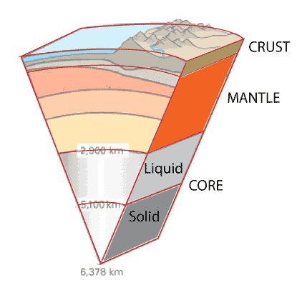
LITHOSPHERE

Slide 24
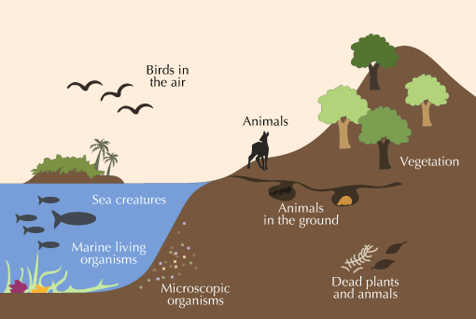
BIOSPHERE

Slide 29
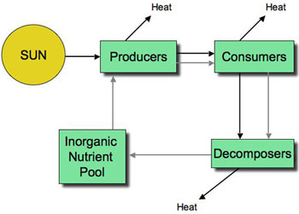
Energy Transfer

Slide 30
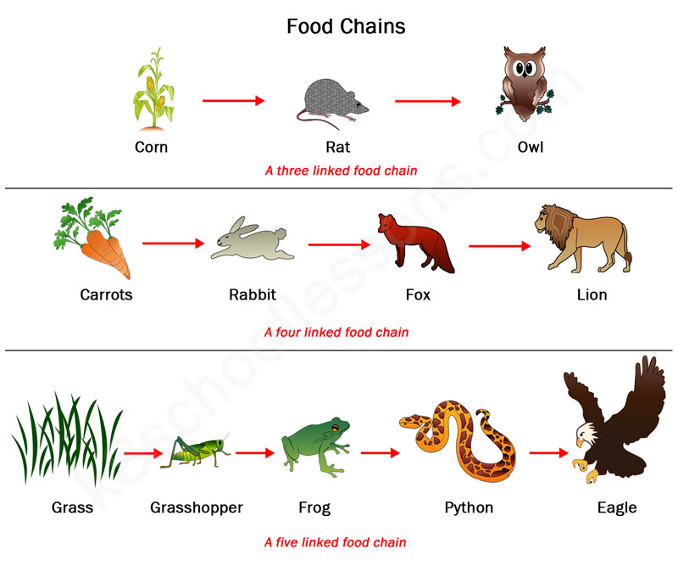

Slide 31
Food Chain
The food chain begins with a producer, which is eaten by a primary consumer. The primary consumer may be eaten by a secondary consumer, which in turn may be consumed by a tertiary consumer. For example, a food chain might start with a green plant as the producer, which is eaten by a snail, the primary consumer. The snail might then be the prey of a secondary consumer such as a frog, which itself may be eaten by a tertiary consumer such as a snake.
So the process of eating and being eaten is called as food chain.
Food chains are very important for the survival of most species. When only one element is removed from the food chain it can result in extinction of a species in some cases. A producer can use either solar energy or chemical energy to convert organisms into usable compounds. Decomposers, which feed on dead animals, break down the organic compounds into simple nutrients that are returned to the soil. These are the simple nutrients that plants require to create organic compounds. It is estimated that there are more than 100,000 different decomposers in existence.

Slide 32
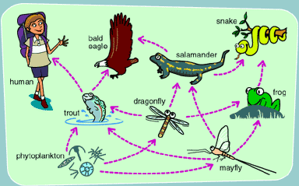
Food web

Slide 33
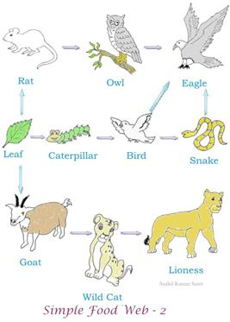

Slide 34
Food Web
Food web is a connection of multiple food chains. Food chain follows a single path whereas food web follows multiple paths. From the food chain, we get to know how organisms are connected with each other.
We can find that the elements of different food chains are interrelated and inter dependent on the elements of other food chains. So combination of different food chain is called as a food web.

Slide 35
Biomass pyramid
Food web is a connection of multiple food chains. Food chain follows a single path whereas food web follows multiple paths. From the food chain, we get to know how organisms are connected with each other.
We can find that the elements of different food chains are interrelated and inter dependent on the elements of other food chains. So combination of different food chain is called as a food web.

Slide 36
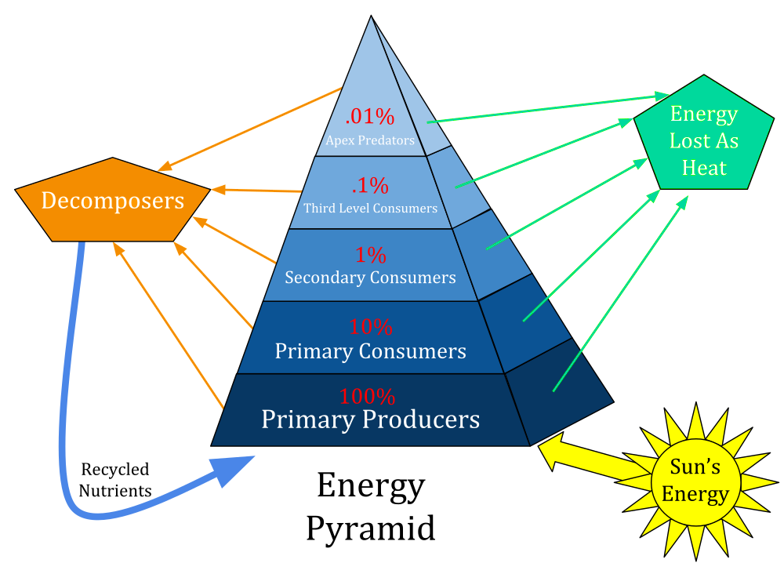

Slide 37
Each food chain consists of different levels. The point of energy transfer from the environment to an organism and from an organism to another defines food chain.
All food chains have three to four levels of energy transfer , which are known as trophic levels.
As one goes up through successive trophic levels , lesser proportion of biomass is transferred at each level. This is because not everything in the lower level gets consumed. Everything that is eaten is not digested. Energy is always being lost as heat.
Much of the energy is lost or released due to respiration of the organisms. An average of about 10% of the energy available in one trophic level will be passed on to the next level so 90% or more of the energy is lost at each trophic level. So the amount of energy reduces considerably as it passes from one trophic level to another. Hence number of consumers at every stage that can survive comfortably is always less than its previous stage.
Energy flow is often characterized as an energy pyramid in which the layers represented by the trophic level shrink towards the apex of the pyramid.

